Slide 1
Beyond Morphology and Resemblance in Early Graphical Culture
Dr. Kathryn E. Piquette, University of Oxford kathryn.piquette@classics.ox.ac.uk

Slide 2
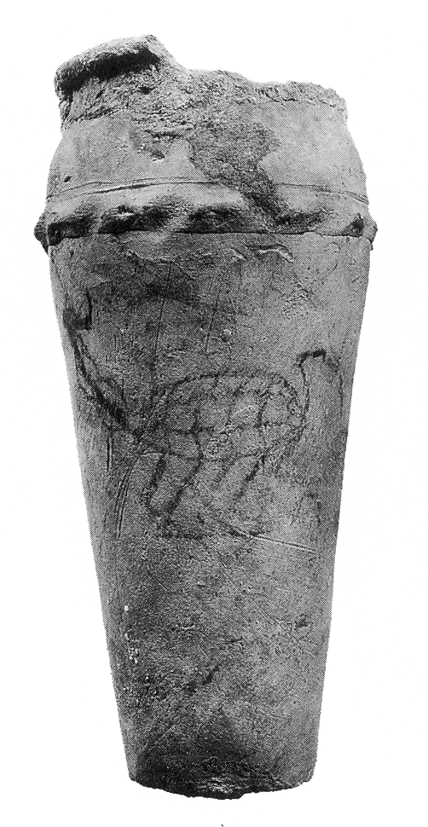
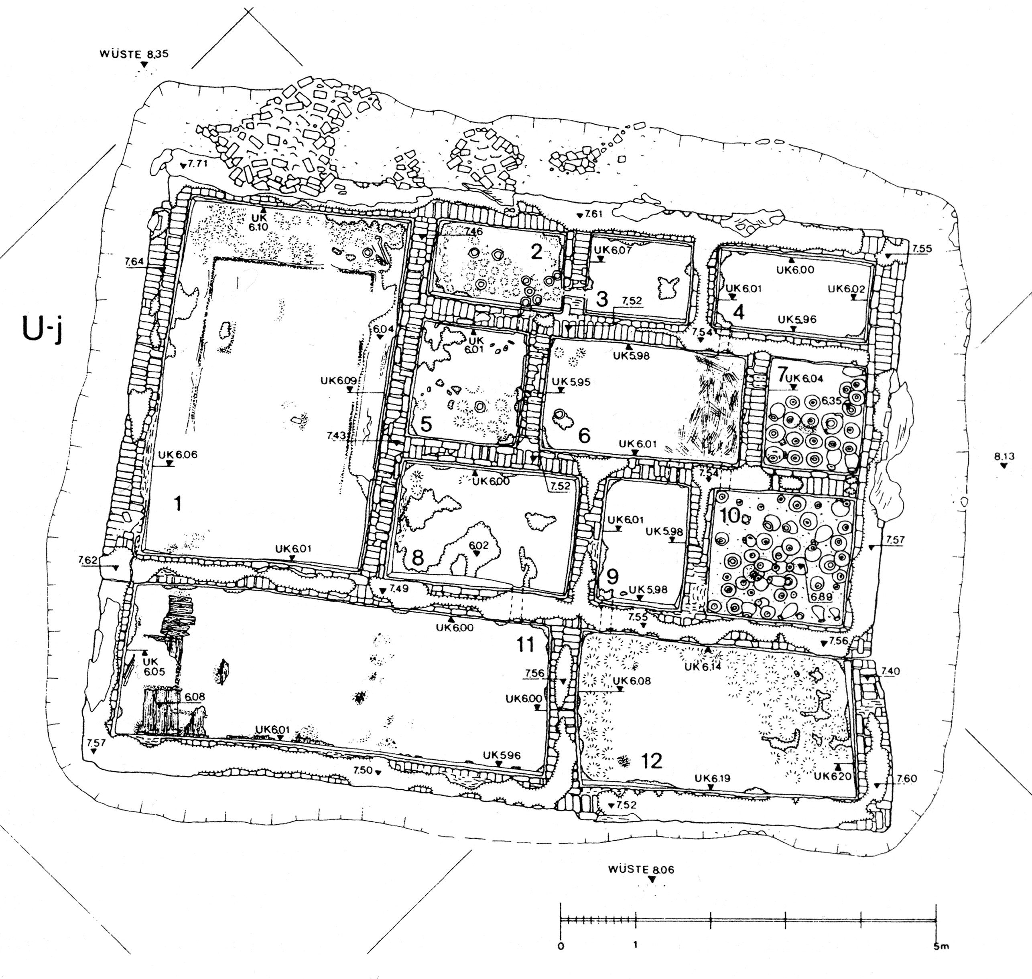
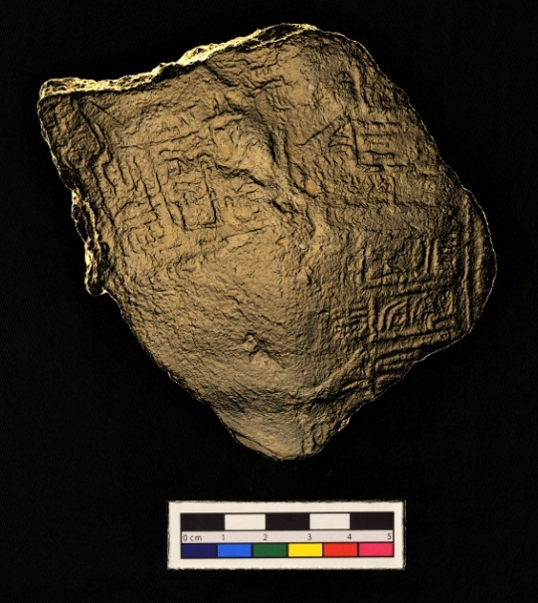
Outline
Criteria to distinguish art from non-art:
Contextual approach
Heuristic assessment of images and clusters
ATLAS.ti
Systematically record graphical imagery
Reflectance Transformation Imaging (RTI)

Slide 3
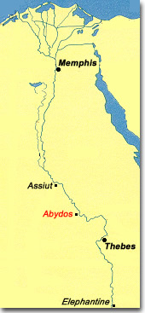
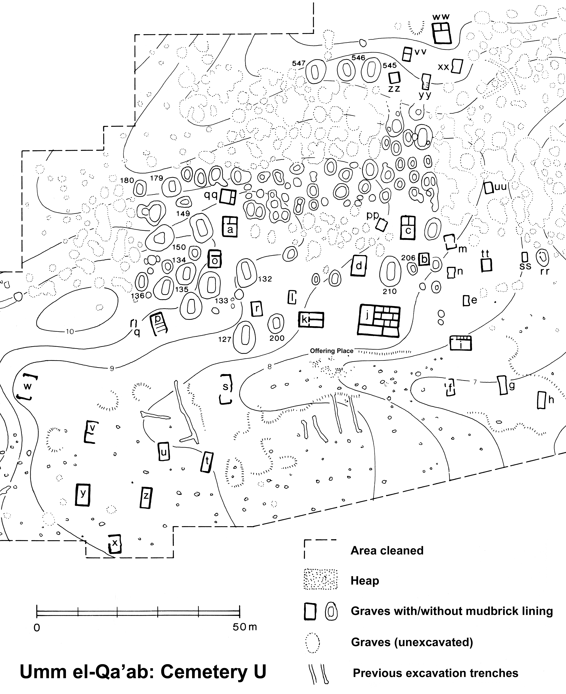
www.ancient-egypt.org/index.html
www.ancient-egypt.org/index.html
Left: Detail of Cemetery U (after Dreyer et al. 1998: 5, fig. 1)
Right: Plan of Tomb U-j (after Dreyer et al. 1998: fig. 2)

Slide 4
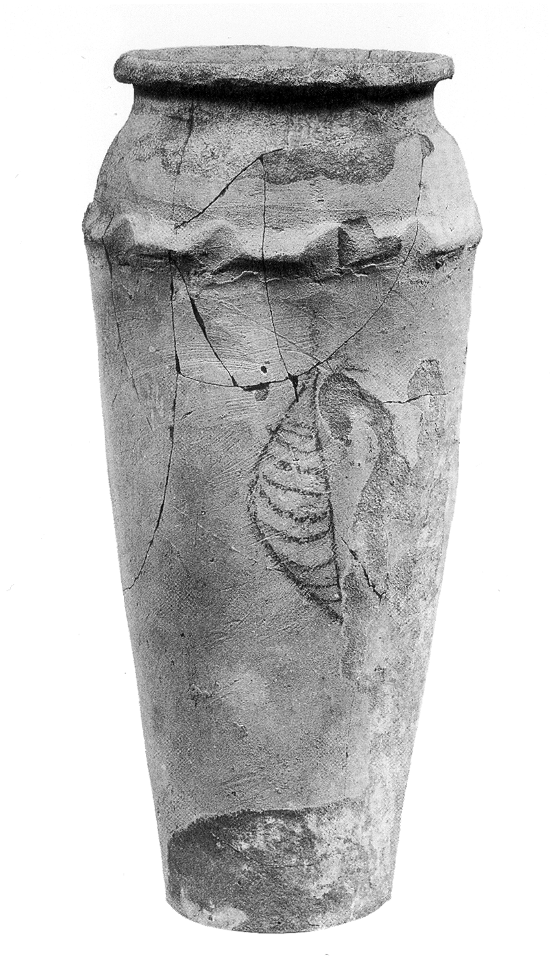
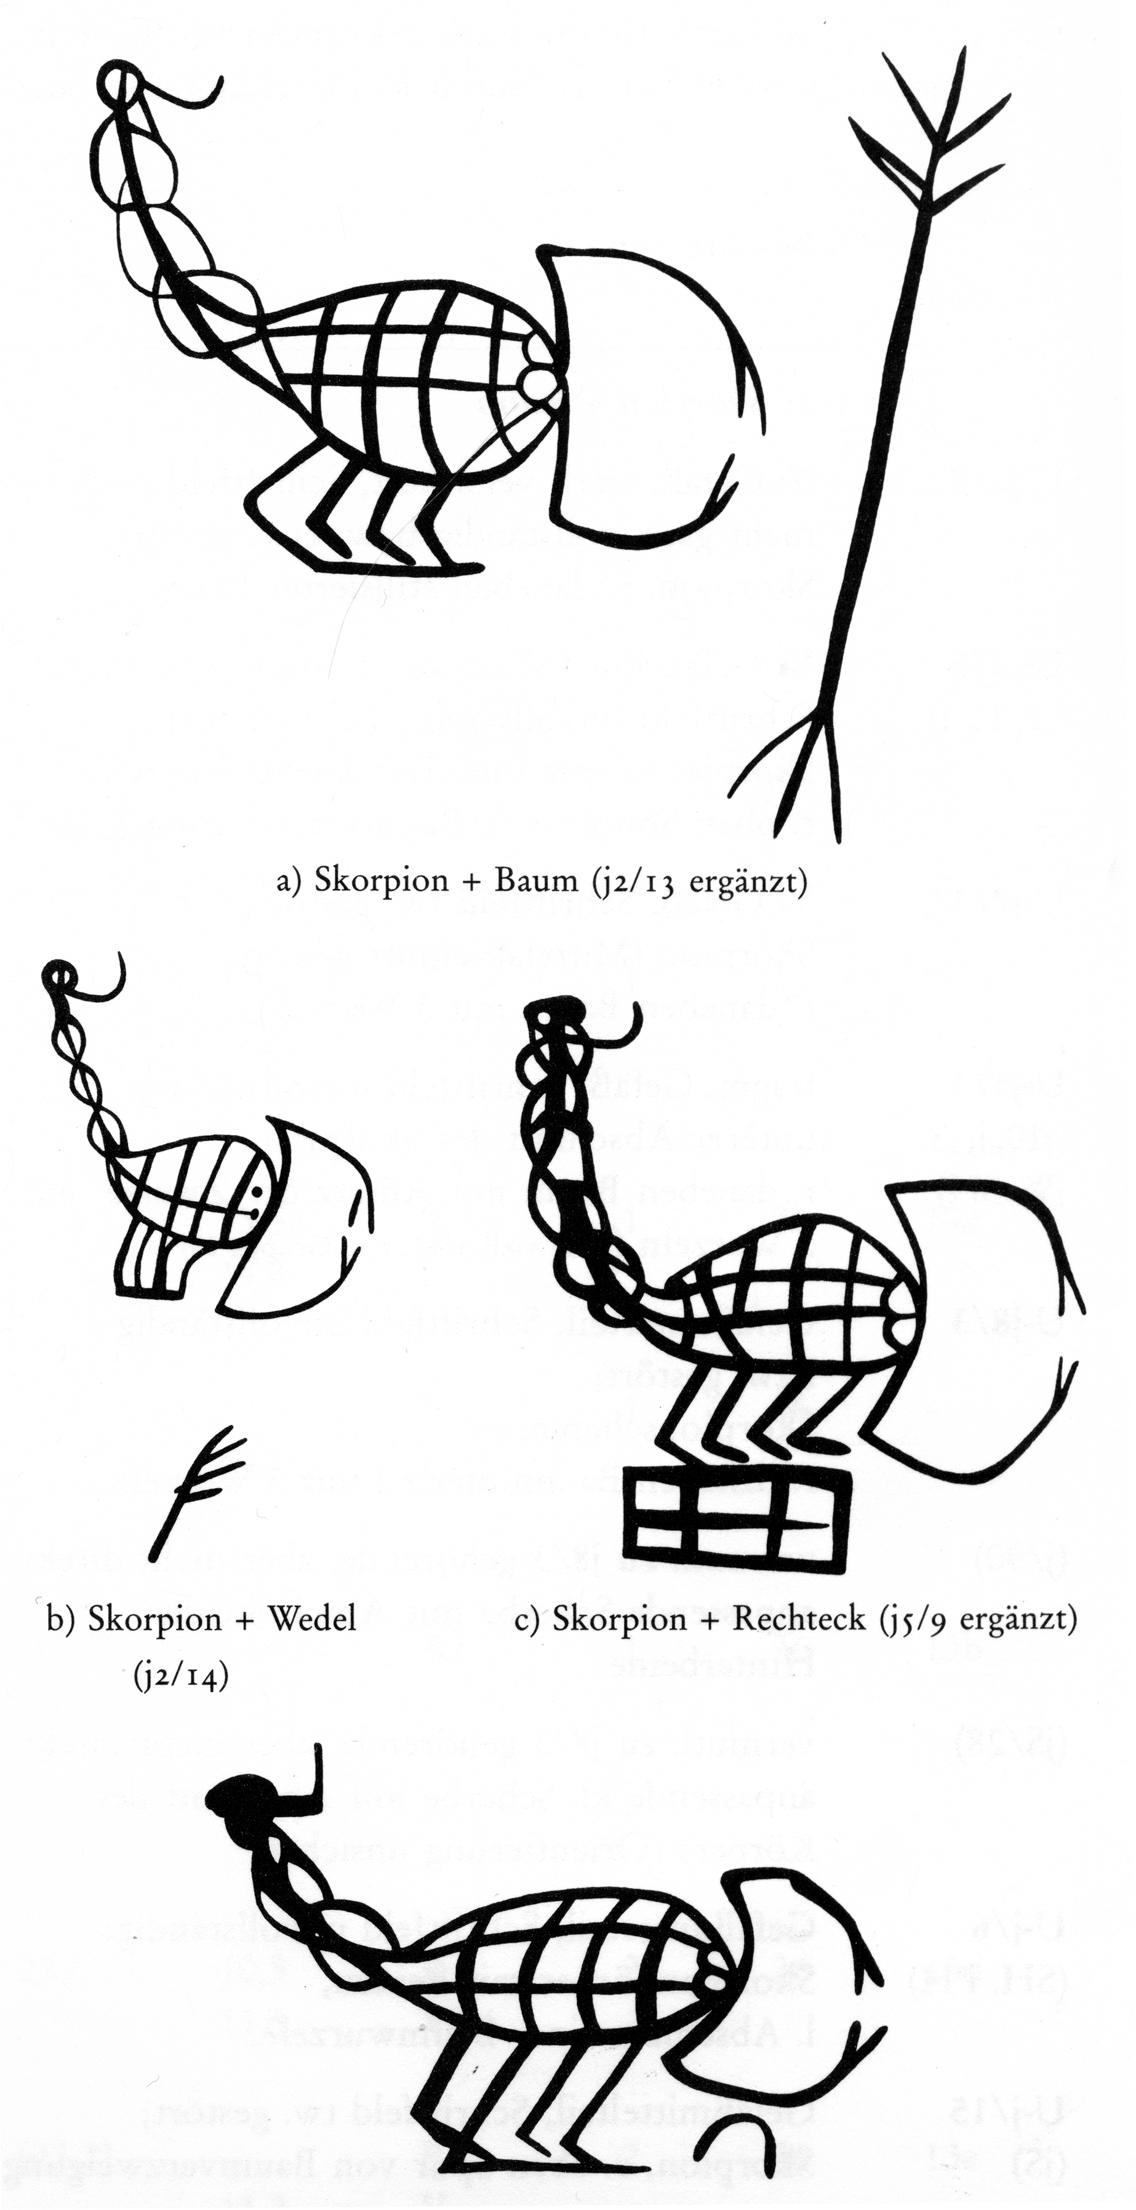
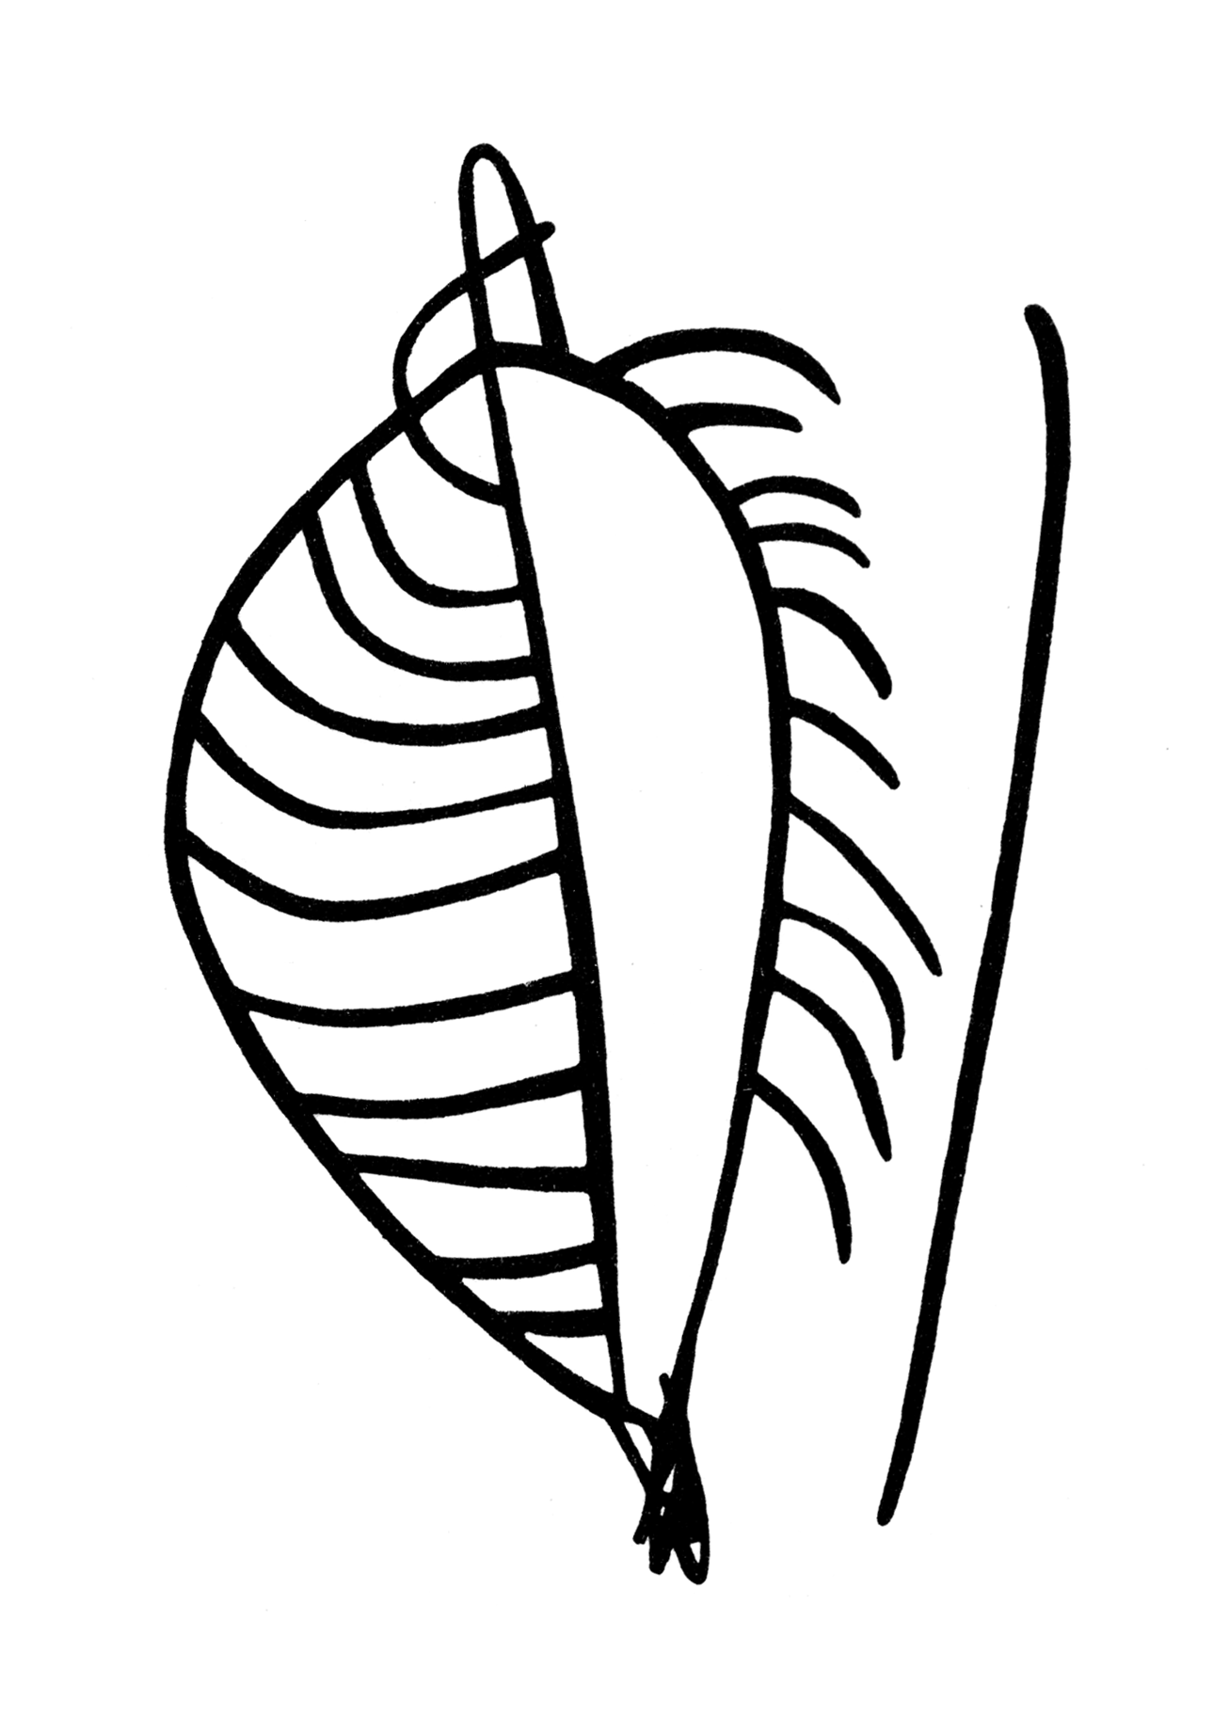
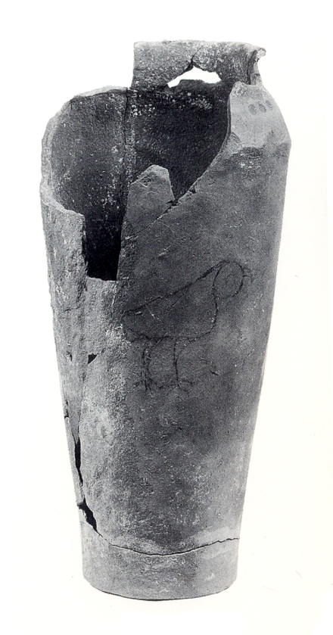
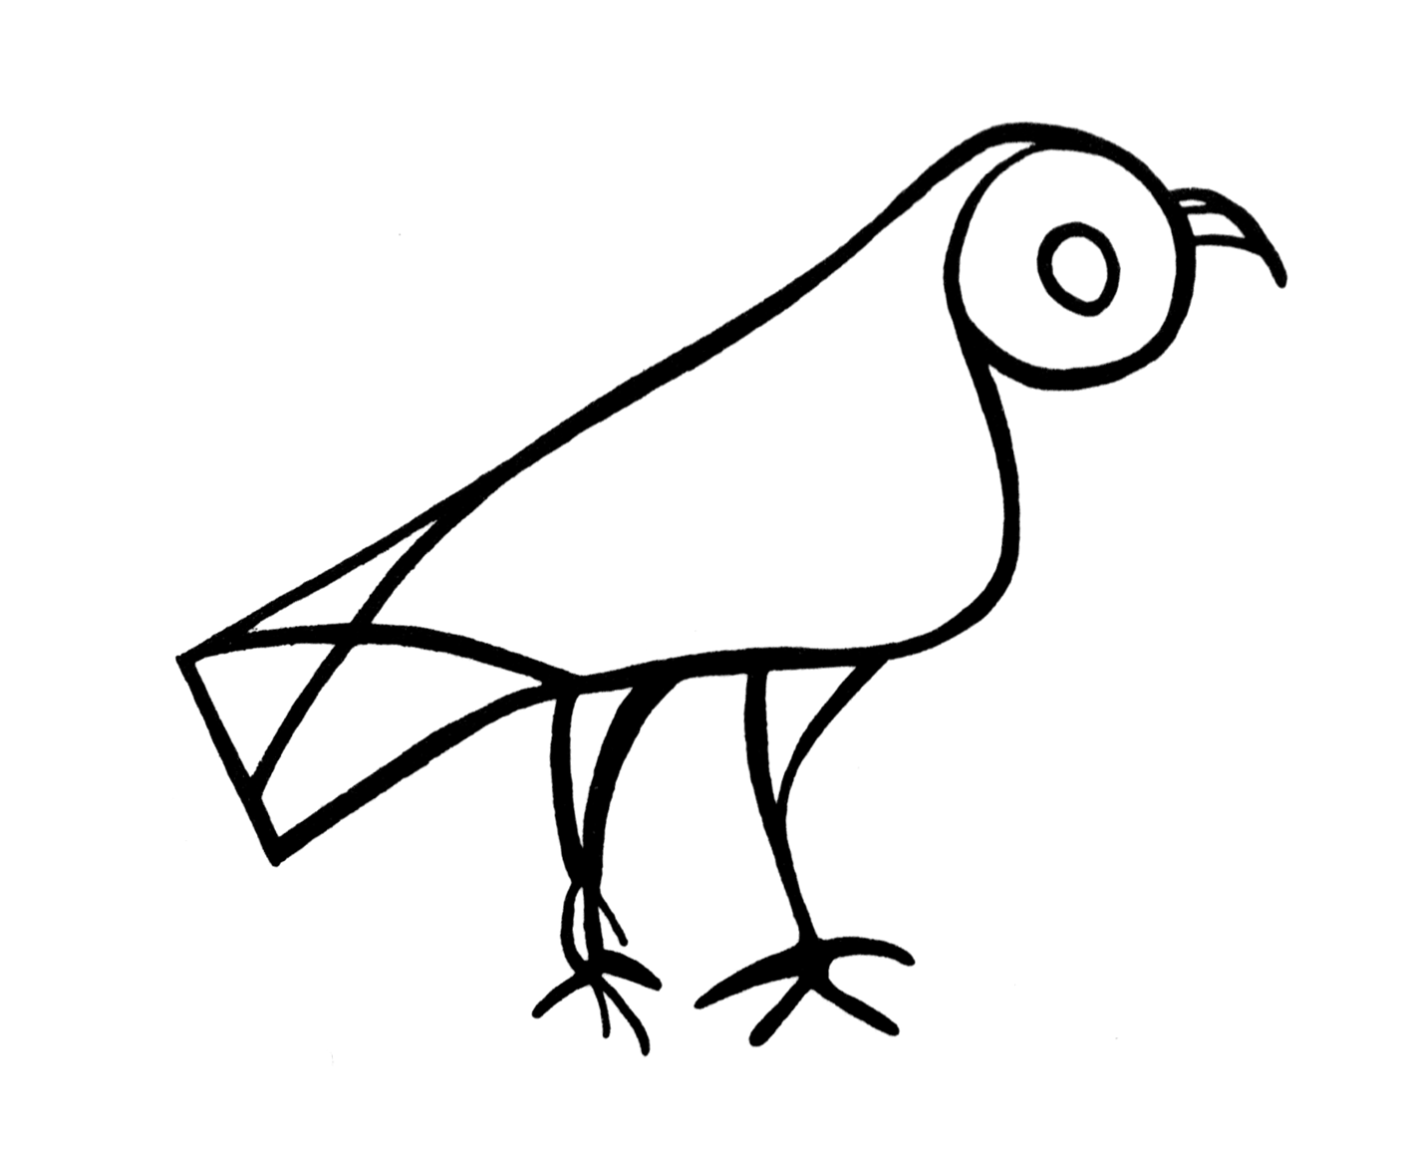
Decorated wavy-handled ceramic jars from Tomb U-j, Abydos (c.3200 BCE; Dreyer et al. 1998)

Slide 5
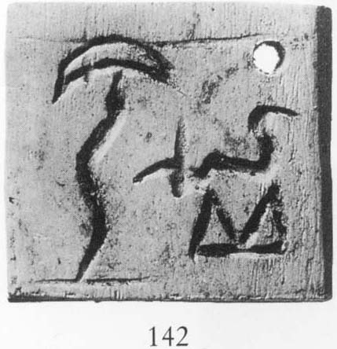
Decorated bone and ivory labels from Tomb U-j, Abydos (c.3200 BCE; Dreyer et al. 1998)

Slide 6
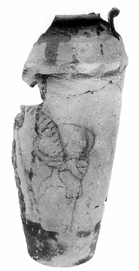
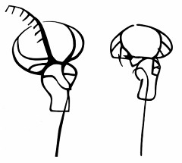
U jars
U labels
All Dreyer et al. 1998

Slide 7
Jars
www.ancient-egypt.org/index.html
Labels
Left: Detail of Cemetery U (after Dreyer et al. 1998: 5, fig. 1)
Right: Plan of Tomb U-j (after Dreyer et al. 1998: fig. 2)

Slide 8
Jars
Criteria
Repertoire
Material
Technique
Scale/size
Object type
Spatial distribution
Temporal context
Labels
After Dreyer et al. 1998
Both Dreyer et al. 1998

Slide 9
2. Heuristic assessment of images & clusters
Atlas.ti: Archiv für Technik, Lebenswelt und Alltagssprache
Developed by Thomas Muhr (Scientific Software Development, now ATLAS.ti GmbH)
Workbench for Qualitative quantitative analysis
Systematic encoding and study of multivariate data in direct relation to digital images of graphical artefacts

Slide 10
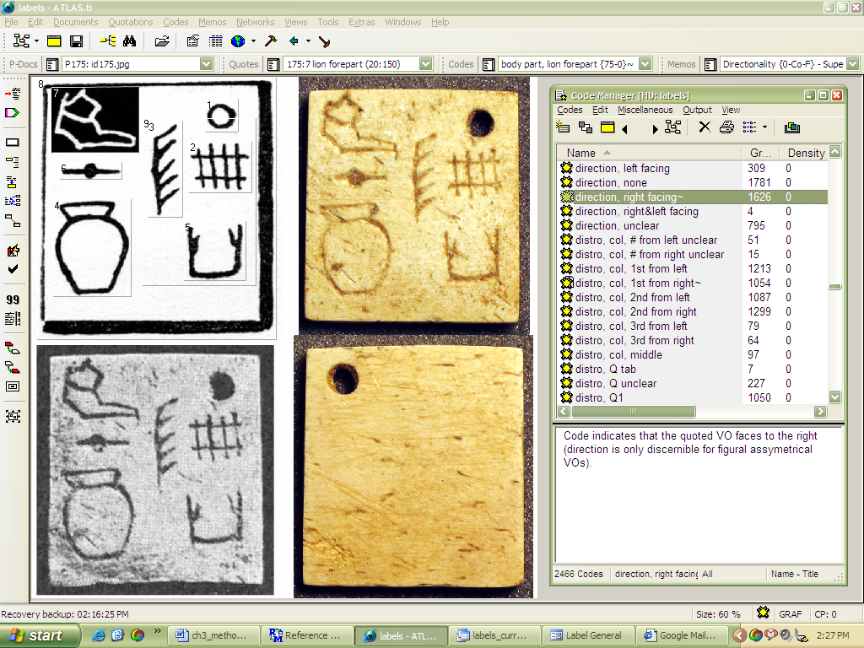
Screenshot of ATLAS.ti Hermeneutic Unit
www.atlasti.com

Slide 11
3. Methods for Systematic Documentation of Marks
Reflectance Transformation Imaging System for Ancient Documentary Artefacts (RTISAD)
University of Southampton and University of Oxford
12-month project funded by the Arts and Humanities Enhancement for Impact (DEDEFI) scheme
Digital images taken of inscribed surface with a camera in a fixed position and illumination applied from different angles
Multiple captures are combined in order to:
Produce interactive, relit records of the surface for details examination of artefacts
Improved documentation and visualisation
First algorithm for photo amalgamation developed by Tom Malzbender of HP labs in 2001, referred to as Polynomial Texture Mapping (PTM)

Slide 12
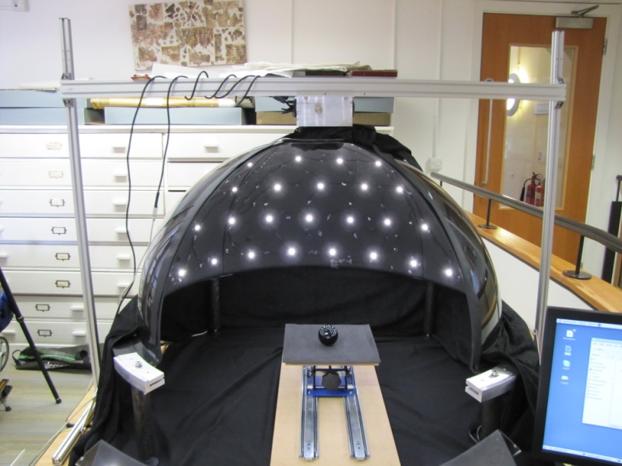
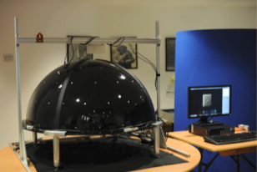
Dome RTI System
Plastic dome in four quarters
76 LEDs
Nikon D3x camera with 105mm, 50mm and 35mm lens
24.5 megapixel resolution
Dome capture: 3.5 min., image amalgamation into PTM: 1.5 min.
Dome with quarter removed to reveal LEDs
Complete dome with PC to control lights and camera

Slide 13
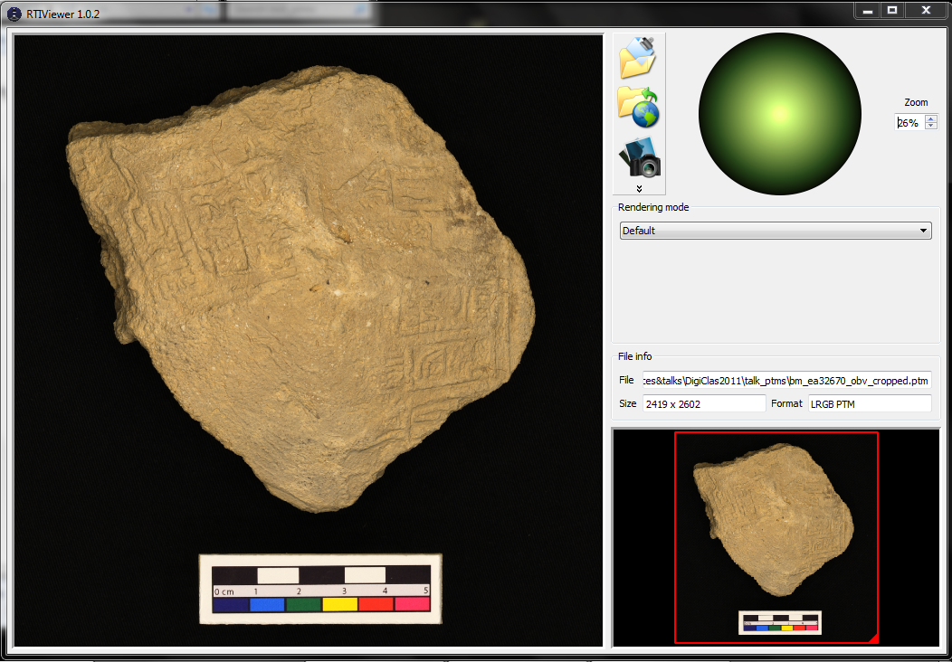
Screenshot of RTIViewer

Slide 14
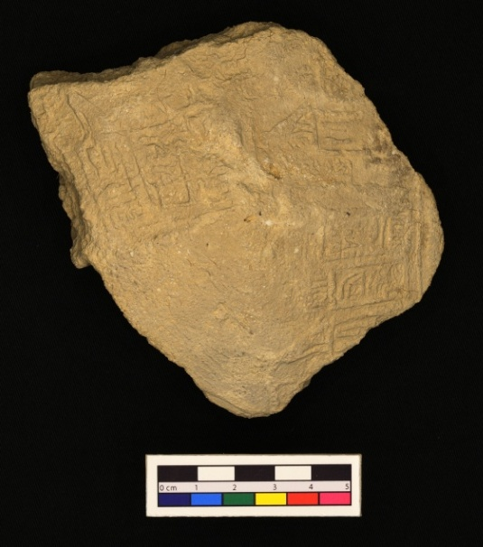
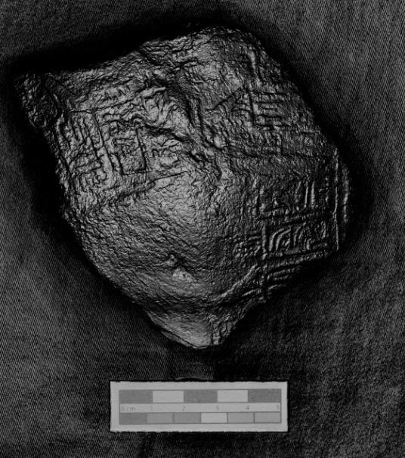
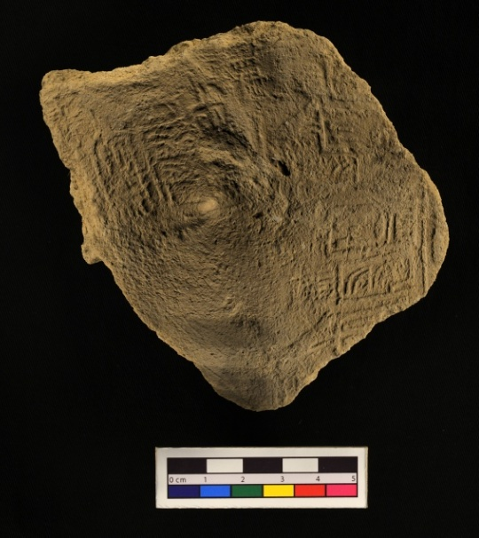
Default
Diffuse Gain
Specular enhancement
Impressed jar sealing, c.2850 BCE, Abydos, EA 32670 (Courtesy Trustees of the British Museum)
Unsharp Masking
Static Multi Light

Slide 15
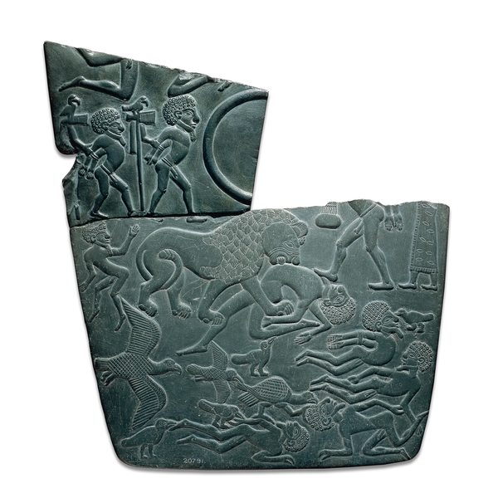
Battlefield Palette, c.3150 BCE, Abydos, EA 20791 (© Trustees of the British Museum)

Slide 17
Normal evenly-it digital photograph of serpentine vessel fragment with incised imagery; 1977.112.296, courtesy World Museum Liverpool

Slide 18
Past graphical images as process and outcome
RTIViewer ‘default’ mode
Specular enhancement rendering mode

Slide 20
Thanks for your attention!
ATLAS.ti
www.atlasti.com
RTI-related links
www.soton.ac.uk/archaeology/acrg/acrg_research_DEDEFI.html
www.soton.ac.uk/archaeology/acrg/acrg_research_PTM.html
c-h-i.org/examples/ptm/ptm.html
www.csad.ox.ac.uk/csad/Newsletters/Newsletter14/Newsletter14.pdf
www.c-h-i.org/learn/media_RTI_viewer/RTIViewer_Guide_102.pdf
kathryn.piquette@classic.ox.ac.uk

