Slide 1
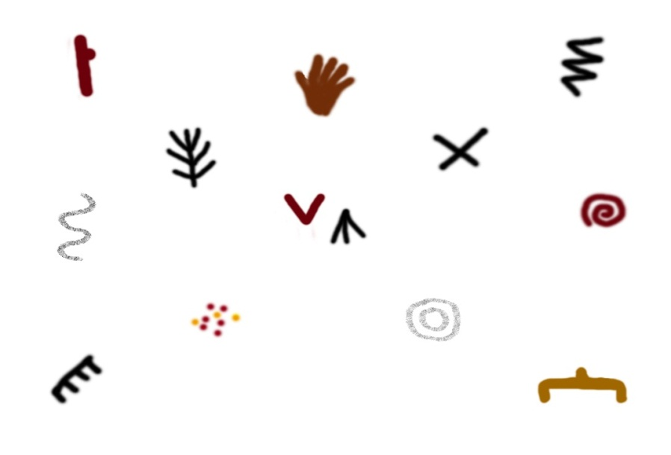
From the Walls to the Grave:
Linking the Parietal and Portable Geometric Signs found in European Upper Paleolithic Art
Genevieve von Petzinger

Slide 2
Europe During the Ice Age
Modern humans reach Europe
by at least 40,000 BP
Adapt to Ice Age environments
Climate impacts all aspects of
life including culture

Slide 3
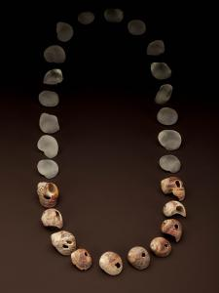
Modern Humans, Modern Behaviour

Slide 4
Ice Age Rock Art
Photo courtesy of B. Defois
Notes:
10,000 to 35,000 years ago in Europe

Slide 5
Many animals, a few humans, and a large number of geometric signs
Photo courtesy of N. Aujoulat

Slide 6
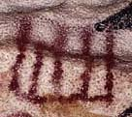
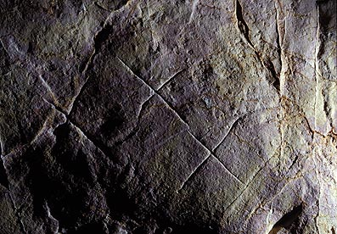
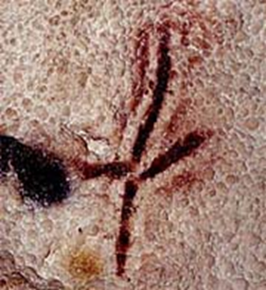
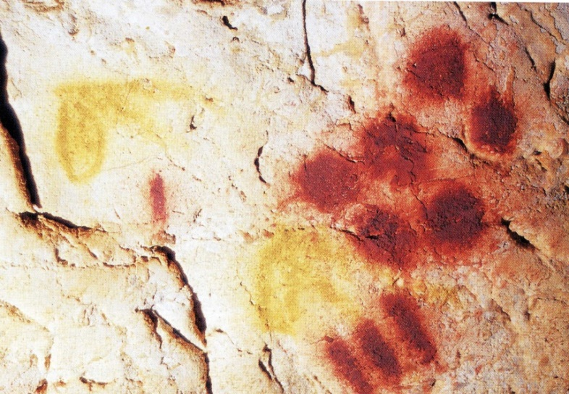
The Geometric Signs
Photos courtesy of J. Clottes, N. Aujoulat and the Bradshaw Foundation

Slide 7
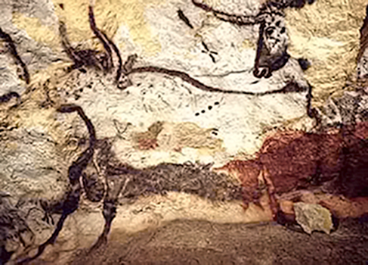
When I started my research…
Photos by: N. Aujoulat
Notes:
I wanted to know how many distinct shapes there were and did the same ones repeat over space and time?

Slide 8
Typology of Non-Figurative Signs

Slide 9
French Rock Art Sites 35,000 – 10,000 BP

Slide 10
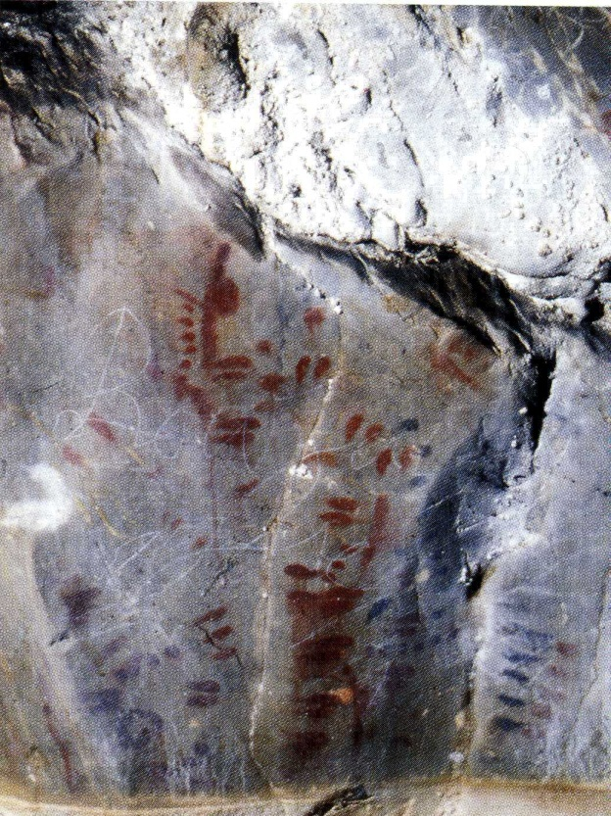
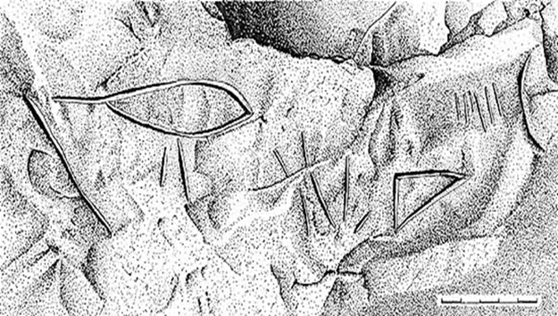
So What Could This Imply?
If they did have significance, and were being used to convey information, then we could be looking at a very early form of graphic communication.
Photo by J. Clottes, drawing by J. Combier and P. Ayroles

Slide 11
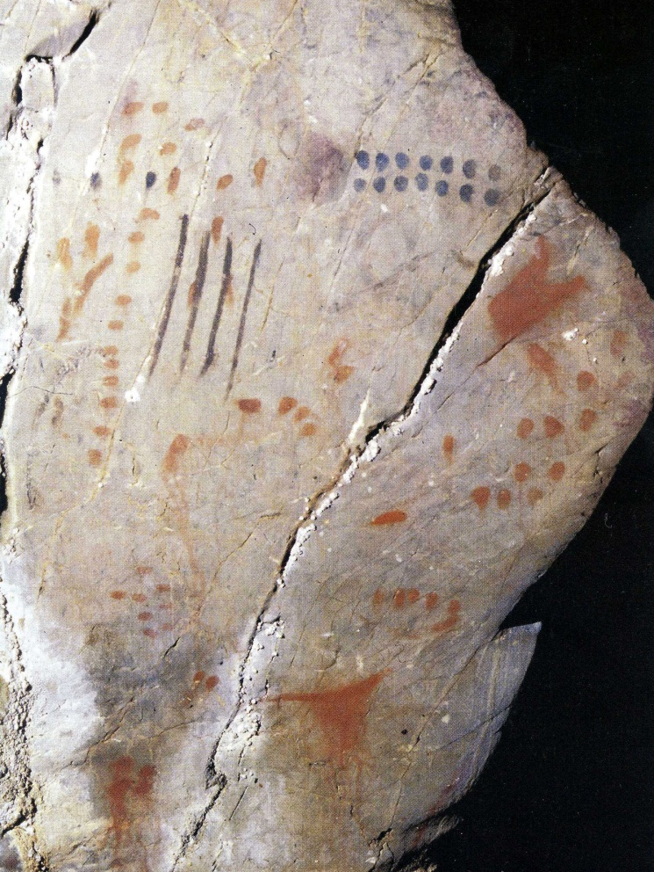
Coulmas’ Basic Criteria for a Writing System
It consists of artificial graphic marks on a durable surface
Its purpose is to communicate something
This purpose is achieved by virtue of the marks’ conventional relation to language
(Coulmas 1989: 17)
Photo by J. Clottes

Slide 12
Conclusions from this Project
There is evidence of the signs being paired in the later half of the Ice Age (after 20,000 BP)
These patterns are being repeated at multiple sites in both France and Spain

Slide 13
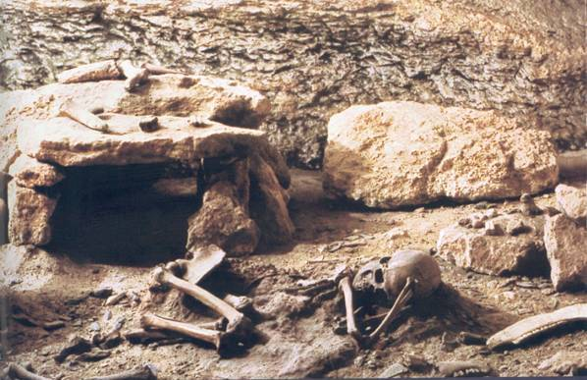
The St. Germain-la-Rivière Burial and Necklace
15,780 year old burial of a young adult female
Grave goods include a necklace made up of 70 red deer canines

Slide 14
The St. Germain Teeth
47 teeth have geometric markings
These teeth are exotic in origin – imported from Spain

Slide 15
Types of Markings
Type 1: 40 teeth with deliberate, clear markings
Type 2: 7 teeth with deliberate but less precise markings
Type 3: 23 teeth with either no markings or marks of production only

Slide 16
Type 1: Deliberate and clear

Slide 17
Type 2: Deliberate but less precise

Slide 18
Type 3: No markings or by-products of production

Slide 19
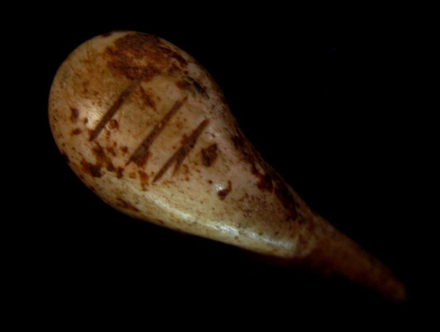
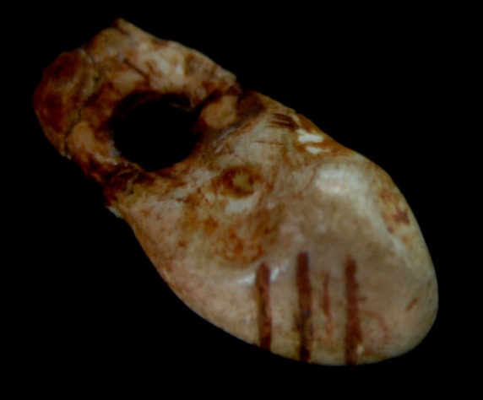
The Site of Bernifal 13,000 – 17,000 BP
Photo/drawing by A. Leroi-Gourhan

Slide 20
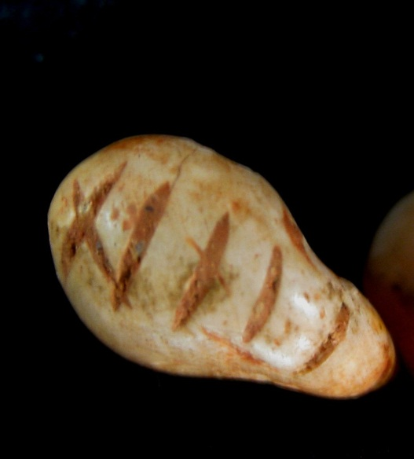
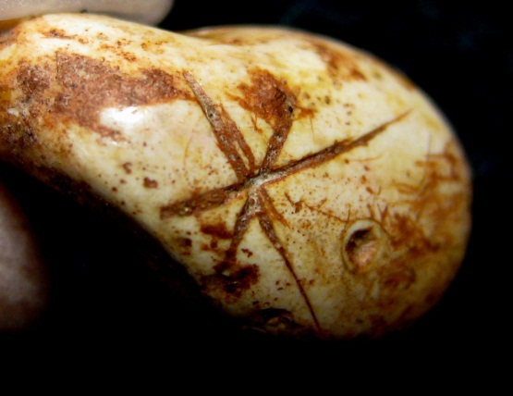
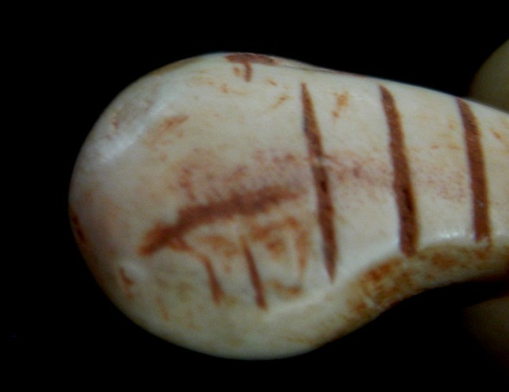
The Site of Gabillou 13,000 – 17,000 BP
Drawings by J. Gaussen

Slide 21
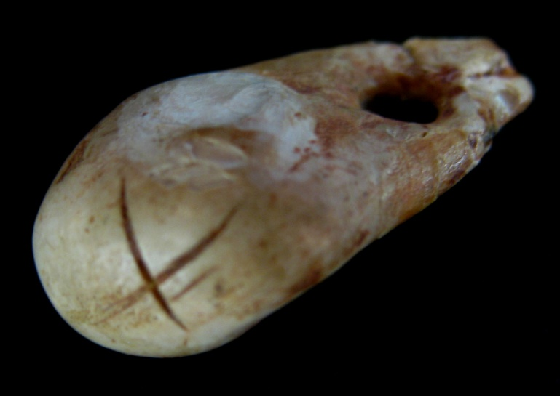
Initial Conclusions
There are matching patterns on cave walls from the same time period
Very few examples of a sign or signs being repeated, most are unique, suggesting the markings are not decorative

Slide 22
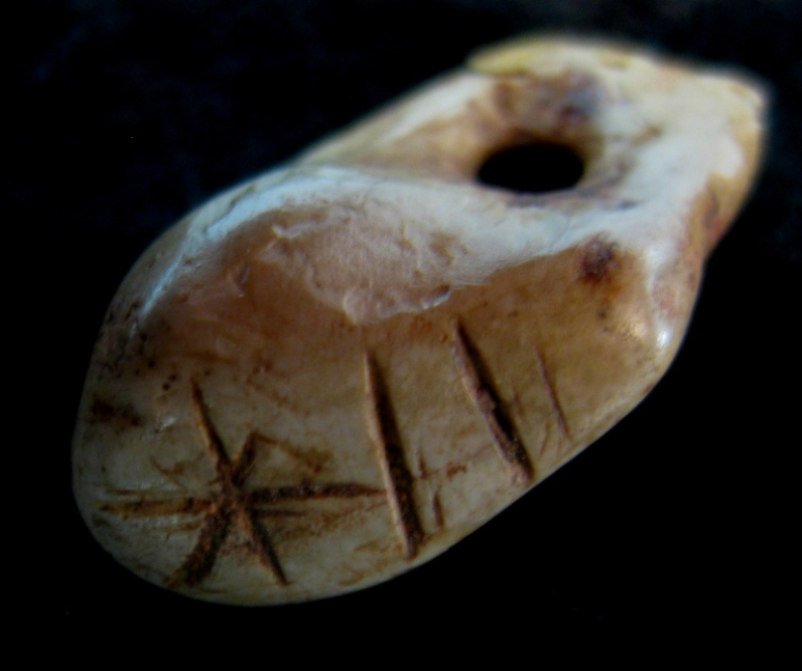
Areas for Further Study
Comparison with geometric signs in Spain could allow us to determine where the markings were made
Better documentation of the signs would allow more accurate matches

Slide 23
Overall Conclusion
Photo by L. F. Sánchez Tundidor

Slide 24
Special thanks to the following individuals and organizations for their support:
Jean and Ray Auel
The Social Sciences and Humanities Research Council of Canada
Musée national de Préhistoire, Les Eyzies-de-Tayac, France, Dr. Cleyet-Merle and Mme. Angotwestin

