Slide 1
A falsifiable hypothesis: semasiography in fourth millennium B.C. Egypt
Martin Uildriks, Leiden University (Netherlands)

Slide 2
Semasiography in Fourth millennium B.C. Egypt
Archaeology
Badarian
Naqada I
Naqada IIA/B
Naqada IIC
Naqada IIIA
Naqada IIIB
Naqada IIIC
Naqada IIID
Chronology
(ca. >4400 – 3900/3800 B.C.)
(ca. 3900/3800 – 3650 B.C. )
(ca. 3650 – 3400 B.C.)
(ca. 3400 – 3300 B.C.)
(ca. 3300 – 3250 B.C.)
(ca. 3250 – 3100 B.C.)
(ca. 3100 – 3000 B.C.)
(ca. 3000 – 2850 B.C.)
(ca. 2850 – 2650 B.C.)
(ca. 2650 – 2575 B.C.)
(ca. 2575 – 2465 B.C.)
(ca. 2465 – 2300 B.C.)
(ca. 2300 – 2150 B.C.)
Text:
Prehistoric
Predynastic (Amratian)
Predynastic (Gerzean)
‘Dynasty 00’
‘Dynasty 00’
‘Dynasty 0’
‘Dynasty 0’
Dynasty 1
Dynasty 2
Dynasty 3 (Old Kingdom)
Dynasty 4
Dynasty 5
Dynasty 6

Slide 3
Semasiography in Fourth millennium B.C. Egypt
Theses 1
Aims:
Gain insight in available elaborate D-Ware iconography types
Study relationships between iconographic components
Thesis 2
Aims:
Gain insight in available D-Ware specimens through cross- referencing earlier lists and other bibliography.
Gain insight in determination-processes, evaluate these processes and explore other plausible suggestions through studying spatial relations of iconography: requires reliable code-system (thesis 1)!

Slide 4
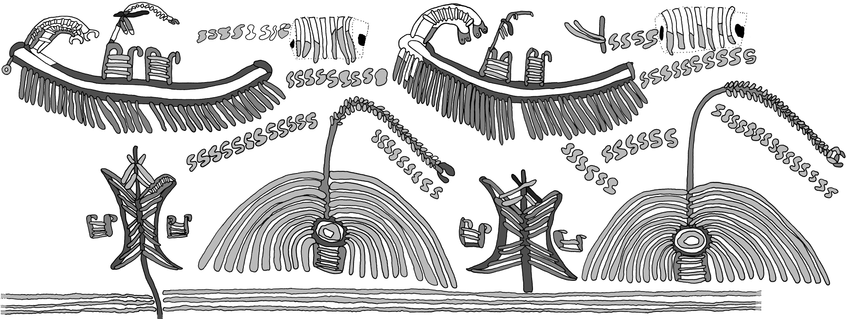
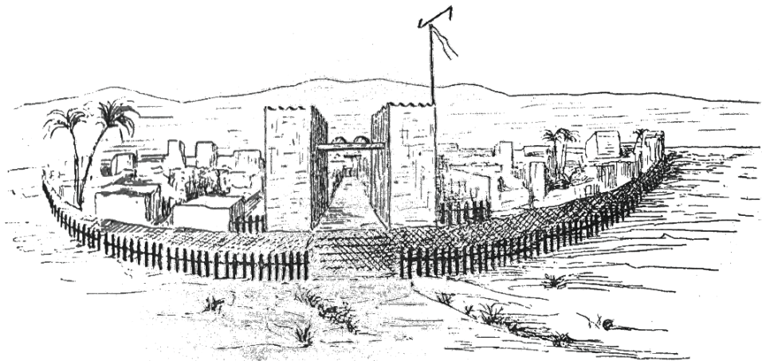
Semasiography in Fourth millennium B.C. Egypt
Drawing by author of E.6200 in the Liverpool University Garstang Museum
VS.
Loret (1906) his alleged town-reconstruction (after Naville 1911, 196: fig. 2).
Another alleged town-reconstruction by Loret (after Naville 1911, 197: fig. 3).

Slide 5
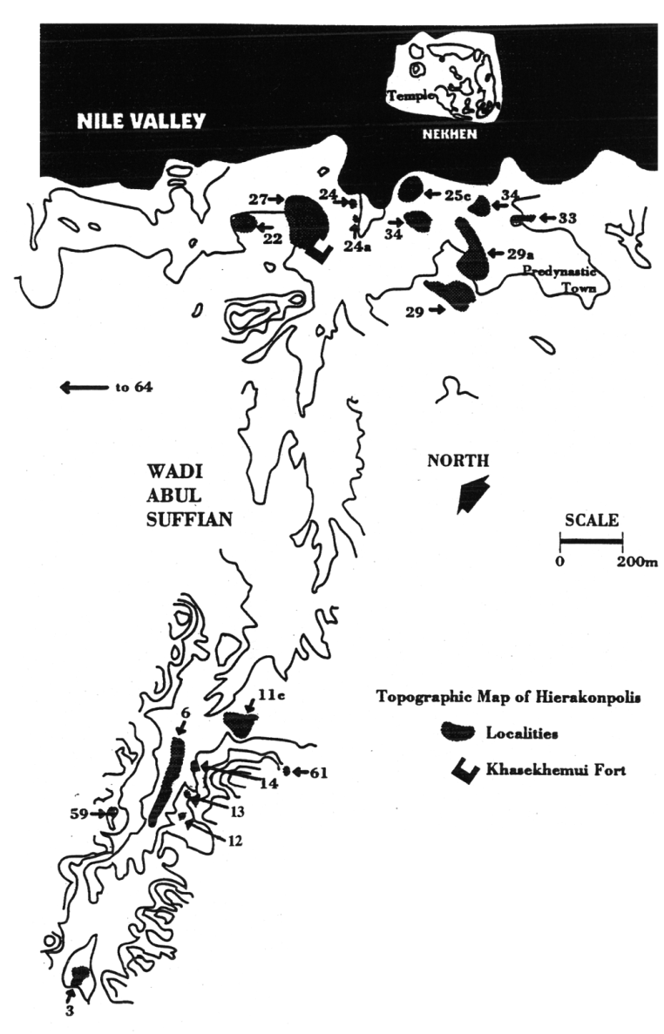
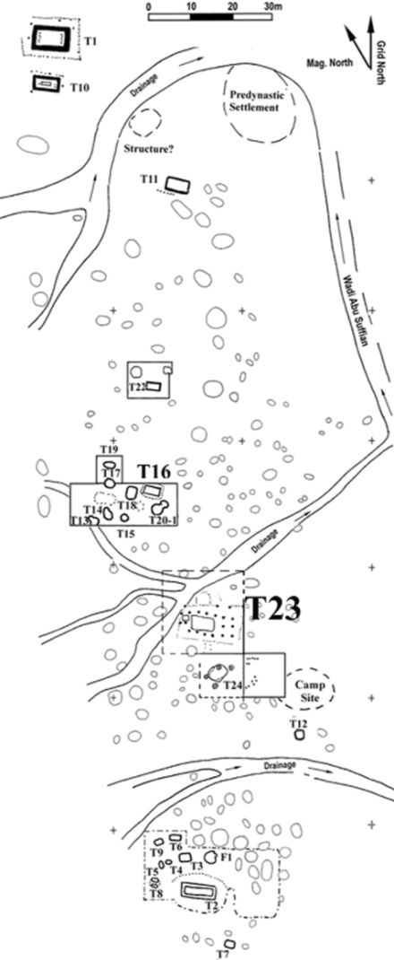
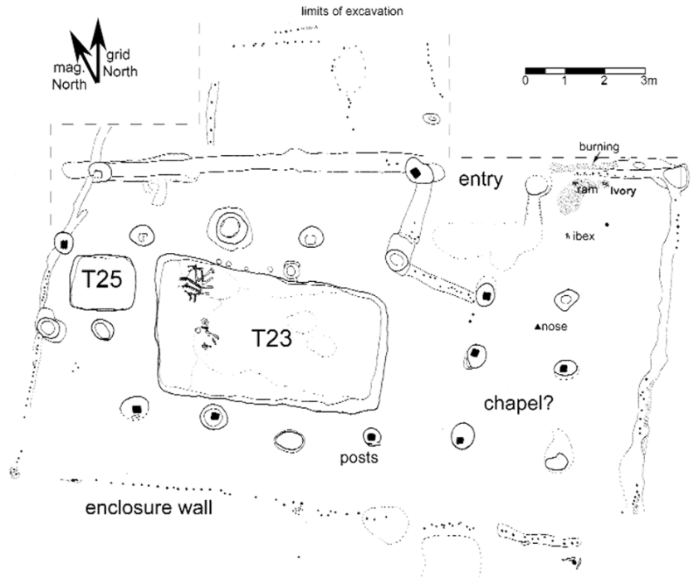
Semasiography in Fourth millennium B.C. Egypt
New evidence from Hierakonpolis, Locality 6:
Plan of Tomb 23 (after Friedman 2005, 4: Plan of the Tomb 23 funerary complex).
Map of HK-6 during the 2004/2005 season (after Anonymous 2005).
The Hierakonpolitan area (after Harlan 1992 in Adams 1995, 28: fig. 5)

Slide 6
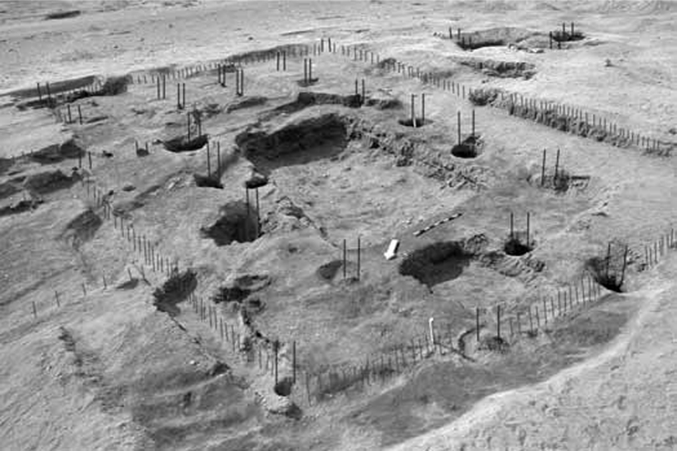
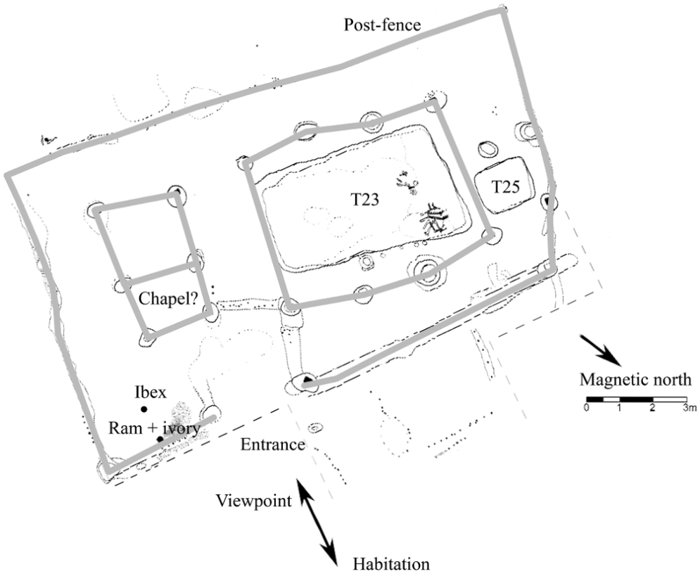
Semasiography in Fourth millennium B.C. Egypt
Reconstruction of Tomb 23’s palisade (after Friedman 2005, 4: The Tomb 23 complex and preliminary reconstruction).
Tomb 23 as map of the galley-construct (after left figure on slide 5).

Slide 7
Semasiography in Fourth millennium B.C. Egypt
If the galley-construct represents an enclosed mortuary superstructure:
¡-unit may represent a palisade
◌-unit is unexplained
Ϡ-unit is unexplained
⌂-unit may represent portable architecture
ך-unit is unexplained
A textual interpretation:
The ◌-unit may have Dynastic scriptural equivalents: cp.
The Ϡ-unit is unexplained, but of its two main-types (‘informal’ and ‘formal’) resembles the older version of
Some ך-units may have Dynastic scriptural equivalents

Slide 8
‘Fishhead-amulet’ (after Hendrickx 1991, no. 26)

Slide 9
Image by author

Slide 10
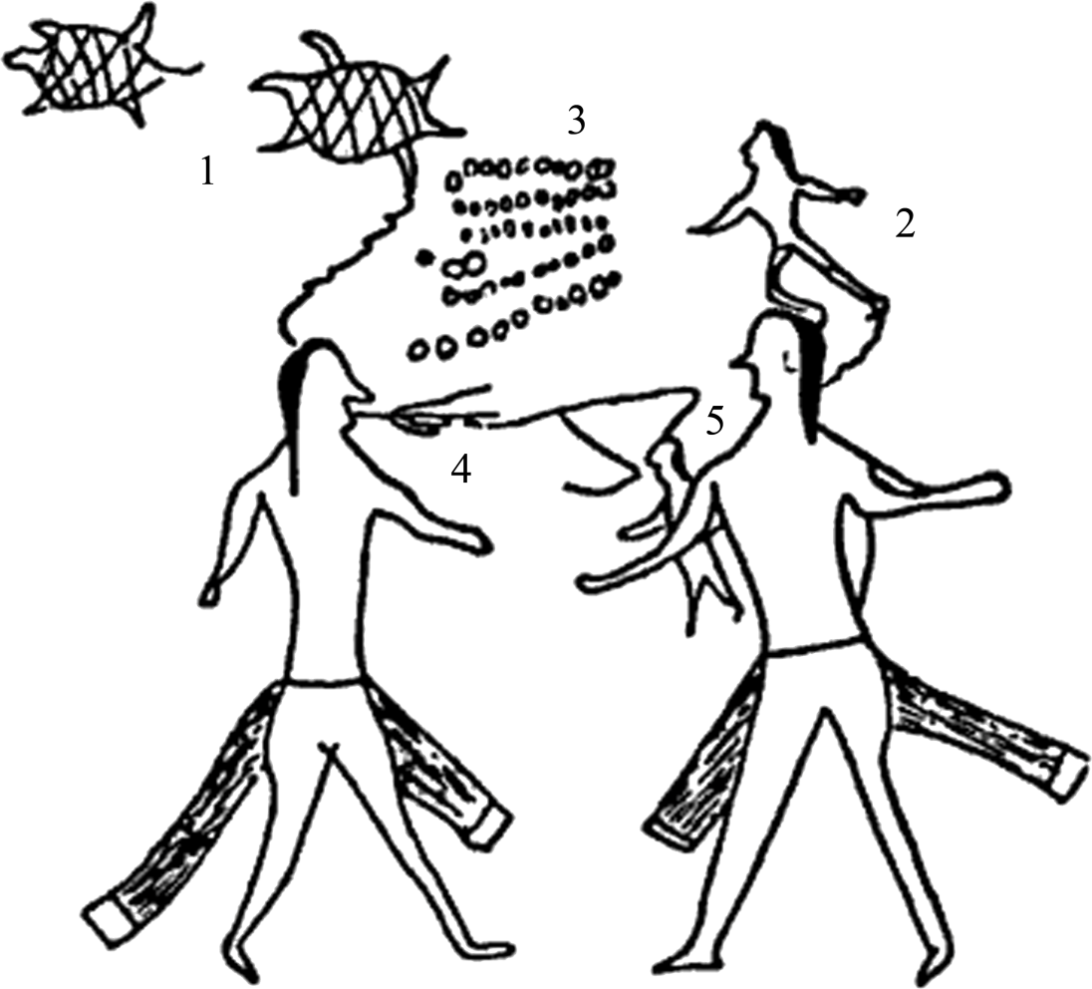
Semasiography in Fourth millennium B.C. Egypt
The Cheyenne Letter (after Rogers 2005, 3: fig. 1.1). 1: Turtle-Following-His-Wife, 2: Little-Man, 3: $53,- , 4: ‘request’/’ask’ and 5: that which is requested.

Slide 11
Semasiography in Fourth millennium B.C. Egypt
Nautical and terrestrial identifications equally possible; earlier terrestrial, later nautical? Shift of ideology?
Highly symmetrical arrangements, but is it still ‘art’? This solely depends on the understanding and following definitions of reading, writing and art:
Segmented vs. non-segmented writing systems: D-Ware may be a non-segmented (operating through semiology) writing system.
The combination of individual conceptual units creates new meaning stimulating development of new graphics and cognition.
Eventually increasing graphic complexity requires supplementation in order to clarify the initial concept.
In late Predynastic Egypt this may have went at least two directions: the iconography and the segmental writing system which then utilized phonetics added to the ‘determinative’.

